Slide 1
创意编程遗传算法
嵇鸿涛

Slide 2
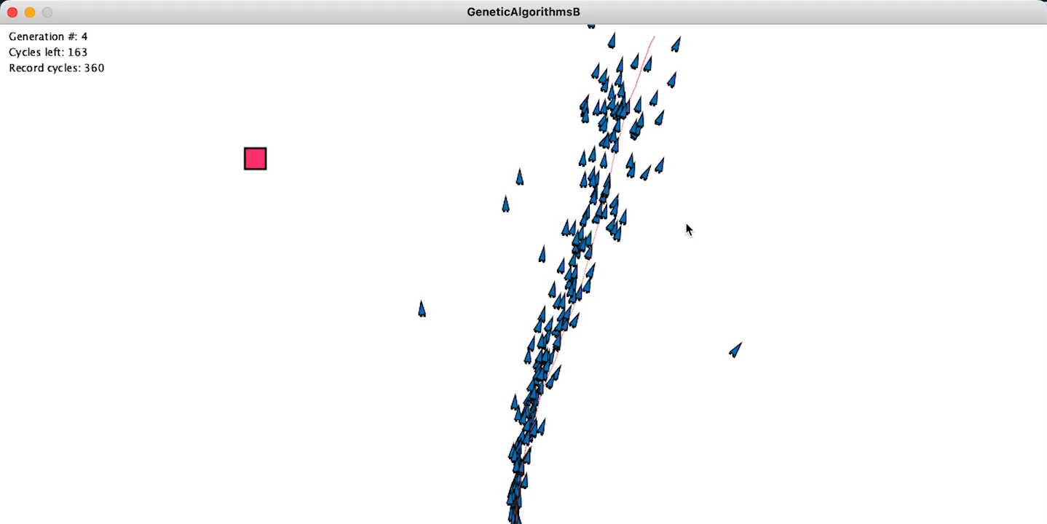
运行视频

Slide 3
Github链接 https://github.com/fanlingxi/Creative-Programming

